Slide 1
Social Pedagogy & Organisational Change Janet Grauberg
SPPA Webinar 22 November 2017

Slide 2
Overview: What would a social pedagogy approach to organisational change look like?
Introduction
Why it matters
What this presentation is (& isn’t)
A minute on organisational theory
The social pedagogy “Diamond Model”
Applying the Diamond Model to organisations
Conclusion
Please ask questions as we go along – don’t wait until the end.

Slide 3
Introduction: Why the issue matters
Definition: social pedagogy is a philosophy of practice, using “education” in its broadest sense to address social issues (Cameron, 2016; Petrie et al, 2009).
Theory: Context matters for work with individuals (Badry & Knapp, 2003)
Practice: My experience is that we encourage strengths-based work, strong relationships, & empowerment in frontline work, but we struggle to apply this in our organisational routines.

Slide 4
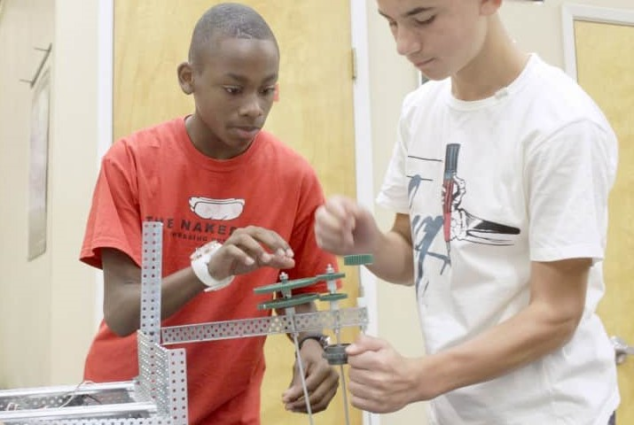
Introduction: The Presentation
Selective
Leaping over philosophical chasms
Leaping over
philosophical chasms
Practical
Standing on the shoulders of giants

Slide 5
A minute on organisational theory
Common metaphors – machines, organisms, brains, political systems.
“Traditional” organisational change approaches conceive organisations as real, objective entities that can be changed by management effort.
Alternative approaches describe organisations as “socially constructed” or “meaning-making systems” with an existence which is multiple, emergent & negotiated.
Partly a matter of time-frame; today’s stance straddles the two.
“Images of Organization” Gareth Morgan (1997)
Van der Ven & Poole (1995).

Slide 6
Social Pedagogy: The Diamond Model
Eichsteller & Holtoff (2011). Image reproduced from http://www.thempra.org.uk/social-pedagogy/key-concepts-in-social-pedagogy/thempras-diamond-model/

Slide 7
The Diamond Model for Organisations
The Diamond – taking a strengths based view of organisational change
Positive experiences – a learning culture
Wellbeing & Happiness – organisational purpose/mission
Empowerment – approach to achieving change
Relationships – understanding others’ worlds
Holistic Learning - approach to sharing good practice

Slide 8
Diamond: We all have a diamond within us....
Organisational Change Aspect: Creating the case for change
Traditional Approach : “diss the present” | Starting point is problem-centred (diagnose, fix, move on). “Create a Sense of Urgency” (Kotter, 1996; 2007). Dissatisfaction Formula (Beckhard and Harris, 1987) C only if (ABD)>X C = the change X = ‘cost’ of changing A = level of dissatisfaction with status quo B = desirability of change D = practicality of the change
Alternative Approach : “look for what’s working & build on that” | Dialogic Organisation Development (Bushe, 2013 p14) “the point…is not to identify, agree upon, and then implement THE change. It is to unearth, catalyze, and support the multitude of motivations and ideas that already exist”. “Possibility-centric & future-focused framing” (Boyd & Bright, 2007) using techniques such as Appreciative Inquiry & Future Search – “what does good look like?” “Positive Deviance” – look for the successful outliers (Leavy, 2011).

Slide 9
Wellbeing & Happiness: The overarching aim of social pedagogy
Organisational Change Aspect: Organisational purpose/ mission/ strategy
Traditional Approach : “Three-year plan” | “Classical scientific management” (Taylor/Ford/Weber). Underlying “unitarism” – change is in all our best interests. Structured Process: Do Analysis (SWOT/PESTLE etc); Set goals; identify & select options; implement change. (Eg. NCVO guide).
Alternative Approach “plausible, emergent,motivating directions of travel” | Strategy as emergent – an observable pattern of past decisions, or crafted as a potter crafts a pot (Mintzberg, 1987). Strategy as “sensemaking” (Weick, 1995). Key facets include Grounded in identity construction – how I see myself in relation to the organisation Retrospective – reducing equivocality about what happened Social & ongoing – creating shared meanings Driven by plausibility rather than accuracy: (p61) “A good story holds disparate elements together long enough to energize and guide action, plausibly enough to allow people to make retrospective sense of whatever happens, and engagingly enough that others will contribute their own inputs in the interest of sensemaking.”

Slide 10
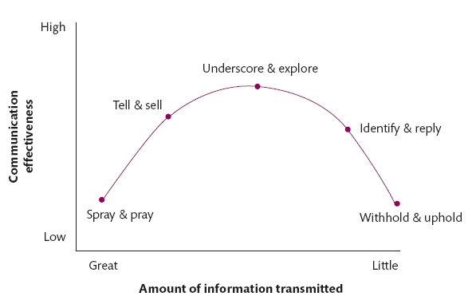
Empowerment: taking part in decisions that affect our lives (1)
Organisational Change Aspect: Approach to achieving change
Traditional Approach : “Securing “buy-in” to change” | Top down, about facts. Success is fidelity to original plan. Limited participation (Lewis & Russ, 2012) Resistance can be dealt with (Kotter & Schlesinger, 1979).
Clampitt et al (2002)

Slide 11
Empowerment: taking part in decisions that affect our lives (2)
Organisational Change Aspect: Approach to achieving change
Alternative Approach “Convers-ations for change; resistance is an indicator to listen more.” | Changing the conversation is achieving the change e.g. the novel concept of “internal customer”(Barrett et al, 1995). “A discourse-centred” understanding of organisational change” (Grant & Marshak, 2011) Discourse is constructive; changing the dominant discourse leads to change; Change narratives are constructed & disseminated via conversations Change discourses emerge from a continuous, iterative & recursive process Alternative discourses exist and may be drawn upon. Resistance is not a thing that “happens over there” but as a perception held by the change agent (Ford et al, 2008). “Resistance” as a resource – to hear what people are saying and engage in the conversation. Important therefore to encourage “resistance” to be open. Can we talk about change without using the word “resistance”?

Slide 12
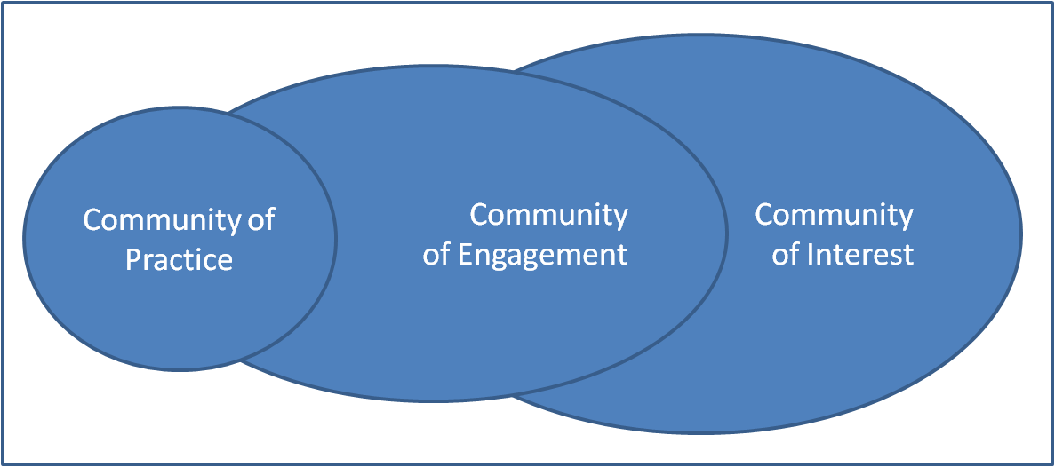
Holistic Learning: learning is continuous & applies to head, heart & hands (1)
Organisational Change Aspect: Sharing Good Practice
Traditional Approach : “Codify & Instruct” | Better evidence will lead to adoption (Spring Consortium, 2016). Classical Implementation Science (Fixsen et al, 2005). Key concepts include model fidelity, implementation stages & teams. “Dissemination” – toolkits, case studies, briefings, conferences. “Objectivist” view of knowledge.
Alternative Approach “Visit, ask questions, try to apply, reflect & learn.” | Tacit knowledge is embedded in practice (Nonaka & Takeuchi, 1995; 2007) & using questions helps to uncover it (Revans, 2011). Understand recipient CMO (Capability, Motivation, Opportunity ) (Michie et al, 2011) Build on inter-organisational learning (Rashman et al, 2009) and communities of practice (Brown & Duguid, 1991; Wenger, 1998;) to build communities of learning (Albury, 2016).

Slide 13
Holistic Learning: learning is continuous & applies to head, heart & hands (2)
Organisational Change Aspect: Sharing Good Practice
Alternative Approach “Visit, ask questions, try to apply, reflect & learn.” | The Grauberg “4S” model: effective spread of innovation results from engagement which is social (to uncover tacit knowledge) situated (to understand context) sustained (to build trust); and which starts with the questions of the learner.
Network of Partners in System Change
Communities of Interest & Engagement
Information & Awareness Activities
Service Tours, Visits & Shadowing
Implementer Action Learning Sets

Slide 14
Positive experiences: A Learning Culture
Organisational Change Aspect: Learning & Improvement Strategies
Traditional Approach : “Performance Indicators” & “Blame Culture” | Alternative Approach: “Reflect; look for learning (including from failure)”
Relationships: Using our personal self to understand others’ worlds
Organisational Change Aspect: Team & Group Dynamics
Traditional Approach : “Ignore if you can” | Alternative Approach: “Pay attention to the relationships – they are where the meaning is made; build networks for change.”

Slide 15
Conclusions
There are some “default” approaches that we take to organisational behaviour & organisational change.
Many of these stem from a “machine” way of thinking about organisations, rather than a relationship-based, shared meaning-making way of thinking.
There is an established body of literature, much of it stemming from “humanistic” approaches, that we can draw on to develop new ways of organisational thinking and being.
But breaking out of paradigms is hard, so we will need to support each other, and continue to learn together.

Slide 16
References
Albury, D. (2016) What works in spreading innovation? London.
Barrett, F. J. (1995) The Central Role of Discourse in Large-Scale Change: A Social Construction Perspective. The Journal of Applied Behavioral Science, 31(3), 352-372.
Beckhard, R. & Harris, R. T. (1987) Organizational Transitions: Managing Complex Change. Reading, Mass.: Addison-Wesley.
Boyd, N. M. & Bright, D. S. (2007) Appreciative inquiry as a mode of action research for community psychology. Journal of Community Psychology, 35(8), 1019-1036.
Brown, J. S. & Duguid, P. (1991) Organizational Learning and Communities-of-Practice: Toward a Unified View of Working, Learning, and Innovation. Organization Science, 2(1), 40-57.
Bruce, I., Copeman, C., Forrest, A., Lesirge, R., Palmer, P. & Patel, A. (2012) Tools for Tomorrow: A practical guide to strategic planning for voluntary organisations. London: NCVO.
Bushe, G. R. (2013) Dialogic OD A Theory of Practice. OD Practitioner., 45(1), 11-17.
Cameron, C. (2016) Social Pedagogy in the UK Today: Findings from Evaluations of Training and Development Initiatives. Pedagogia Social. Revista Interuniversitaria., 27, 199-223.
Clampitt, P. G., DeKoch, R. J. & Cashman, T. (2000) A strategy for communicating about uncertainty. Academy of Management Executive, 14(4), 41-57.
Eichsteller, G. & Holthoff, S. (2012) The Art of Being a Social Pedagogue : Developing Cultural Change in Children’s Homes in Essex. The International Journal of Social Pedagogy, 1(1), 30-46.

Slide 17
References (cont)
Fixsen, D., Naoom, S., Blase, K., Friedman, R. & Wallace, F. (2005) Implementation Research: A Synthesis of the Literature.Tamps, FL.
Ford, J. D., Ford, L. W. & D'Amelio, A. (2008) Resistance to change: The rest of the story. Academy of Management Review, 33(2), 362-377.
Grant, D. & Marshak, R. J. (2011) Toward a Discourse-Centered Understanding of Organizational Change. The Journal of Applied Behavioural Science, 47(2), 204-235.
Kaska, M. (2015) Social Pedagogy: An invitation. London: Jacaranda Recruitment Ltd.
Kotter, J. P. (2007) Leading Change: Why Transformation Efforts Fail. Harvard Business Review, (January 2007).
Kotter, J. P. & Schlesinger, L. A. (1979) Choosing strategies for change. Harvard Business Review, (March-April), 106-114.
Leavy, B. (2011) Leading adaptive change by harnessing the power of positive deviance. Strategy & Leadership, 39(2), 18-27.
Lewis, L. K. & Russ, T. L. (2012) Soliciting and using input during organizational change initiatives: What are practitioners doing. Management Communication Quarterly, 26(2), 267-294.
Michie, S., van Stralen, M. M. & West, R. (2011) The behaviour change wheel: a new method for characterising and designing behaviour change interventions. Implementation science, 6(1), 42.
Mintzberg, H. (1987) Crafting strategy. Harvard Business Review, 65(4), 66-75.
Morgan, G. (1997) Images of organization. [2nd ed.]; London: Sage.

Slide 18
References (cont)
Nonaka, I. (2007) The Knowledge-Creating Company. Harvard Business Review, 85(7/8), 162-171.
Nonaka, I. & Takeuchi, H. (1995) The knowledge-creating company: How Japanese companies create the dynamics of innovation. Oxford: Oxford University Press.
Petrie, P., Boddy, J., Cameron, C., Heptinstall, E., McQuail, S., Simon, A. & Wigfall, V. (2009) Pedagogy - a holistic, personal approach to work with children and young people, across services: European models for practice, training, education and qualification. London: Thomas Coram Research Unit, Institute of Education.
Rashman, L., Withers, E. & Hartley, J. (2009) Organizational learning and knowledge in public service organizations: a systematic review of the literature. International Journal of Management Reviews, 11(4), 463-494.
Revans, R. (2011) ABC of action learning. Swansea: Gower Publishing, Ltd.
Spring-Consortium (2016) Children’s Social Care Innovation Programme Interim Learning Report, 2016. Available online: http://springconsortium.com/wp-content/uploads/2015/01/DfE-Innovation-Programme-Interim-Learning-Report.pdf [Accessed 30 March 2016].
Van der Ven, A. H. & Poole, M. S. (1995) Explaining Development and Change in Organizations. Academy of Management Review, 20(3).
Weick, K. E. (1995) Sensemaking in Organizations. London: Sage Publications.
Wenger, E. (1998) Communities of practice: learning, meaning, and identity. Cambridge, UK: Cambridge University Press.

